Slide 1
AI Horizon – a new area of creativity and innovation
Presentation Title
AI Horizon – a new area of creativity and innovation
October 8 – 9, 2024, Tirana, Albania
Author1¹, Author2¹, Author3¹
¹Affiliation
University

Slide 2
Table of Contents
1. Introduction
2. Section
3. Conclusions
AI Horizon – a new area of creativity and innovation

Slide 3
Table of Contents
Introduction
Section
Conclusions
AI Horizon – a new area of creativity and innovation

Slide 4
Introduction
This is the Beamer template for the 2024 IEEE 20th International Conference on Automation Science and Engineering. In the following, you will find some basic examples for the most common LATEX objects.
AI Horizon – a new area of creativity and innovation

Slide 5
Table of Contents
Introduction
Section
Conclusions
AI Horizon – a new area of creativity and innovation

Slide 6
Section (I)
This is the first bullet
This is the first item of a sub list for the first bullet
And (if you really need it) we have the subsub list as well
and this is the second bullet
and this is the third bullet
Equations (clearly)
AI Horizon – a new area of creativity and innovation

Slide 7
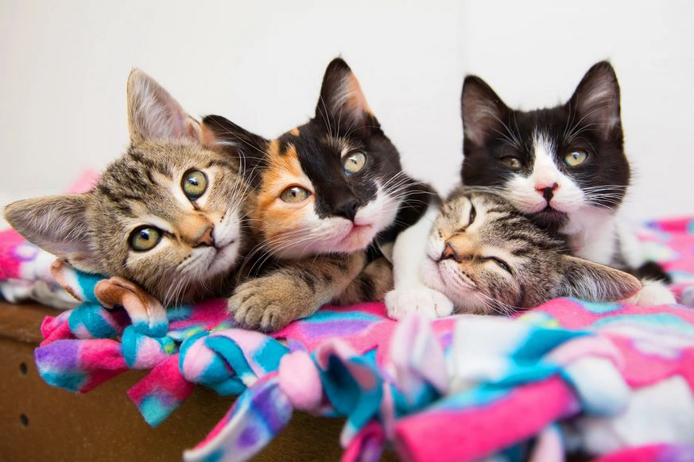
Section (II)
You can add a caption for Figures as well
AI Horizon – a new area of creativity and innovation

Slide 8
Section (III)
And we have tables as usual...
Country List
Country Name or Area Name | ISO Code | ALPHA | 2 | ISO Code | ALPHA | 3
Afghanistan Aland Islands Albania Algeria American Samoa Andorra Angola | AF AX AL DZ AS AD AO |  |  | AFG ALA ALB DZA ASM AND AGO
You can add a caption for Figures as well
AI Horizon – a new area of creativity and innovation

Slide 9
Section (IV)
Definition (Fibration)
A fibration is a mapping between two topological spaces that has the homotopy lifting property for every space X.
Lemma
Given two line segments whose lengths are a and b respectively there is a real number r such that b = ra.
Proof.
To prove it by contradiction try and assume that the statement is false, proceed from there and at some point you will arrive to a contradiction.
AI Horizon – a new area of creativity and innovation

Slide 10
Table of Contents
Introduction
Section
Conclusions
AI Horizon – a new area of creativity and innovation

Slide 11
Conclusions
Aenean velit sem, viverra eu, tempus id, rutrum id, mi. Nullam nec nibh. Proin ullamcorper, dolor in cursus tristique, eros augue tempor nibh, at gravida diam wisi at purus. Donec mattis ullamcorper tellus. Phasellus vel nulla. Praesent interdum, eros in sodales sollicitudin, nunc nulla pulvinar justo, a euismod eros sem nec nibh. Nullam sagittis dapibus lectus. Nullam eget ipsum eu tortor lobortis sodales. Etiam purus leo, pretium nec, feugiat non, ullamcorper vel, nibh. Sed vel elit et quam accumsan facilisis. Nunc leo. Suspendisse faucibus lacus.
AI Horizon – a new area of creativity and innovation

Slide 12
AI Horizon – a new area of creativity and innovation

